Slide 1
Radial Visualization
Nate Phillips

Slide 2
Goals
To design a novel visualization method.
To examine its effectiveness, compared to the standard line chart.

Slide 3
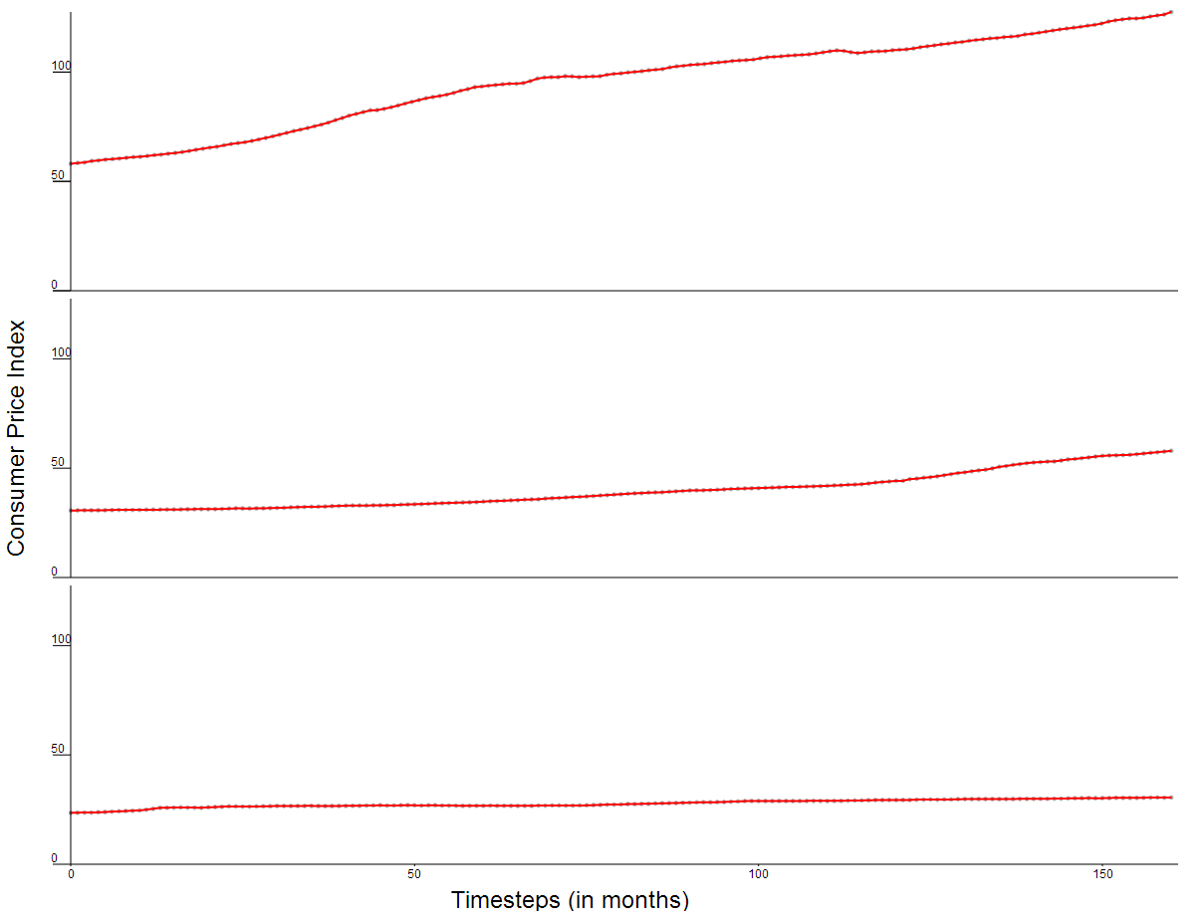
Concept
The idea is to represent a line chart on a circle.
The objective of this is to make it easier to see periodic trends in the data.
Notes:
Data: CPI Data

Slide 4
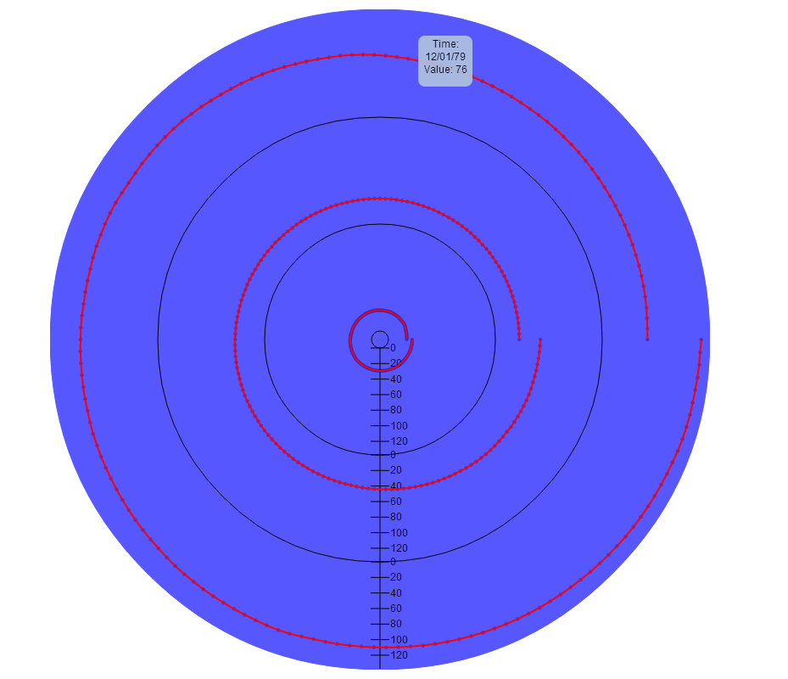
Visualization

Slide 5
Interaction
Users can specify:
Type of visualization (line graph vs. radial visualization)
Data range
Number of partitions

Slide 6
Results
Issues:
Harder to see small data changes on radial visualization.
For both, it is hard to see any changes in data for a large number of partitions.
Possible solutions:
Different data
A zoomed-in view
Notes:
Thus, I conclude that, currently, the line graph is superior to the radial visualization, but that it would be possible to make improvements to the visualization to make it more effective.

Slide 7
Questions?

